Slide 1

Movie Recommender System
Enhancing Movie Discovery and User Experience
Submitted by:
Tae Hwan Kim & Denver magtibay

Slide 2

Objective:
The objective of this presentation is to introduce and explore our movie recommendation system, designed to enhance movie discovery and improve user experience.

Slide 3
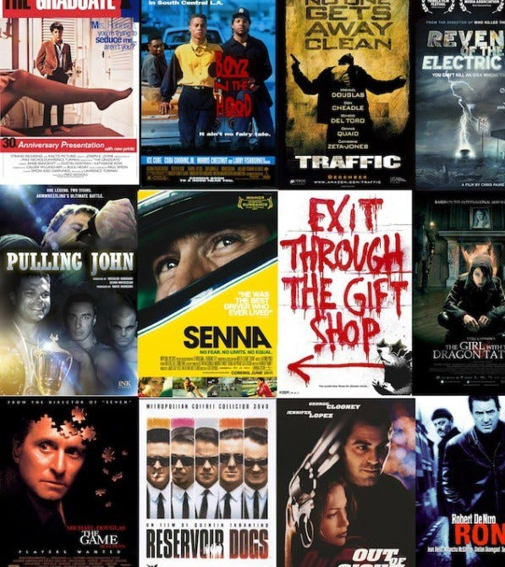
Background:
With the exponential growth of digital media platforms and the vast amount of content available, users often struggle to find movies that match their preferences and interests. In response, our recommendation system aims to address this challenge by providing personalized movie suggestions tailored to each user's tastes.

Slide 4
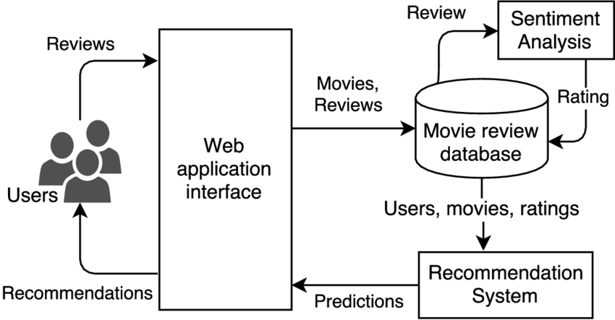



Recommender System Framework

Slide 5
Study Approach
Input
Model
Approach
Simple recommender
Movie Description-Based Recommender
Metadata-Based Recommender
Enhanced Recommender Incorporating Popularity and Ratings
Weighted Rating
TFIDF + Cosine similarity
TFIDF + Cosine similarity + Count Vectorizer
Weighted Rating + XX percentile
Rating
1
1
Movie Description
Movie Tagline
2
2
Genre
Crew (i.e. Director)
Main Actors
Keywords
3
3
Popularity
Rating
4
4

Slide 6
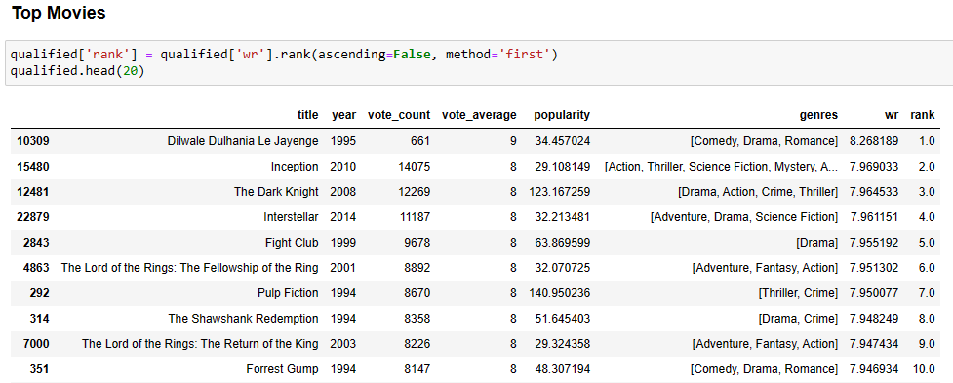
Model 1: Simple Recommender
Summary
The Simple Recommender offers broad movie recommendations based on overall popularity and critical acclaim, catering to a general audience's preferences. By sorting movies based on ratings and popularity, users can easily discover top-rated and popular films. Additionally, users can specify a genre to receive tailored recommendations, enhancing their movie discovery experience.
The algorithm utilizes TMDB Ratings and IMDB's weighted rating formula to calculate a weighted rating for each movie, considering factors like the number of votes and average rating. By determining the minimum votes required for inclusion in the chart and filtering movies accordingly, the recommender ensures that only highly rated and popular films are showcased in the Top Movies Chart. This approach provides valuable insights into trending and acclaimed movies, empowering users to make informed movie choices based on their preferences and interests.

Slide 7
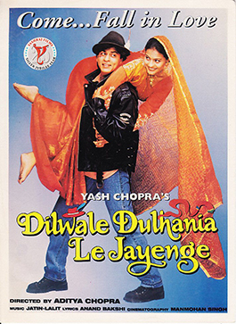

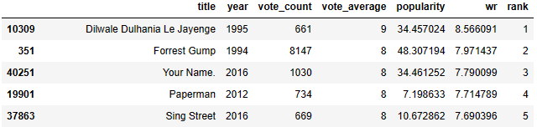



Top 5 Romance Movies

Slide 8
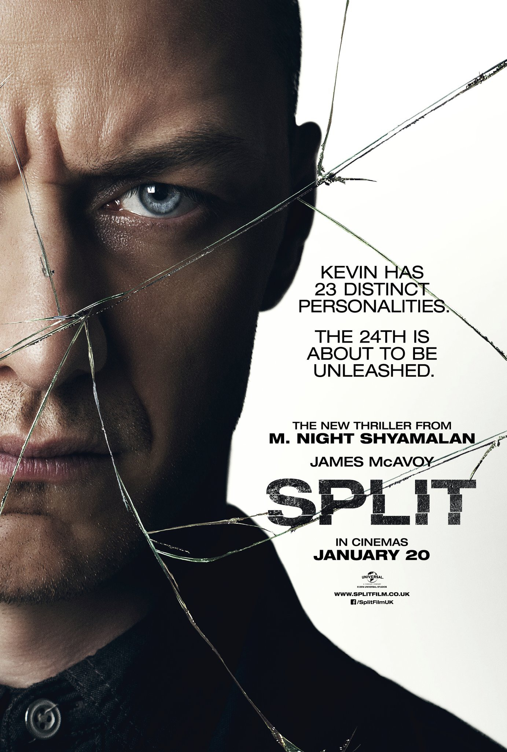

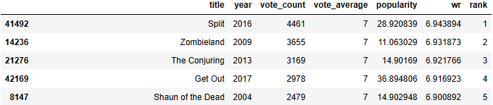



Top 5 Horror Movies

Slide 9

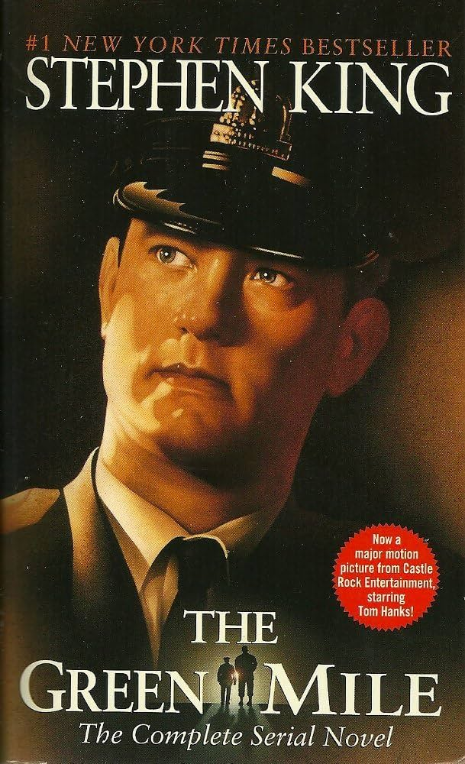
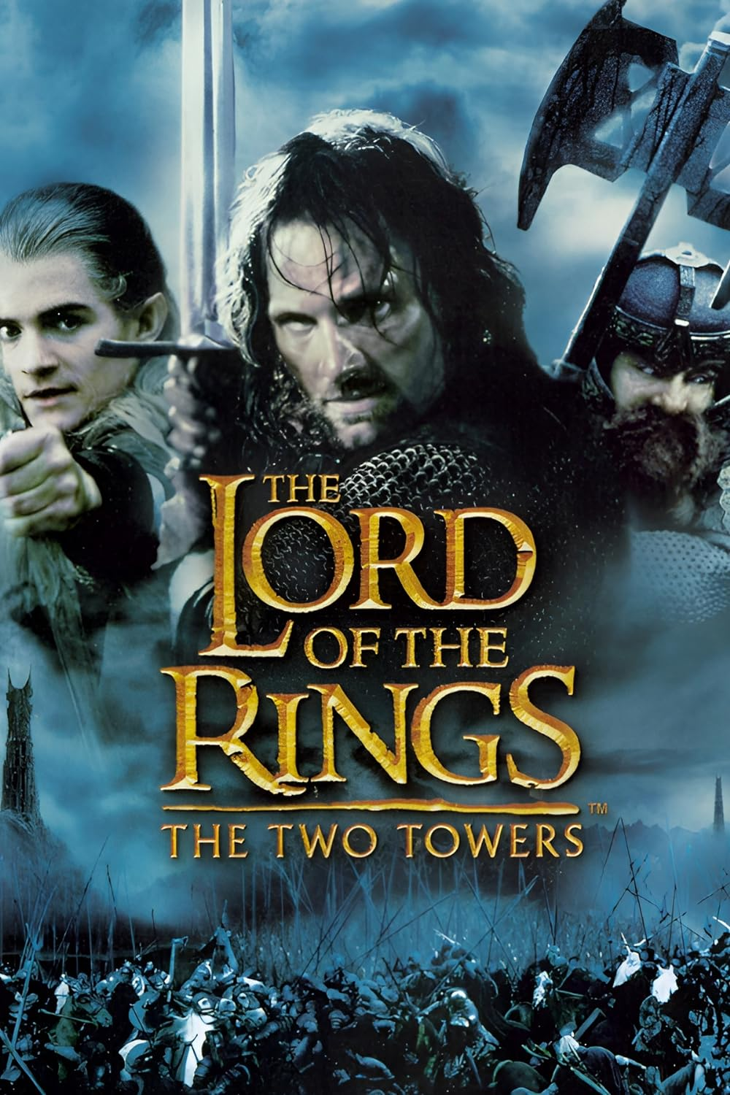
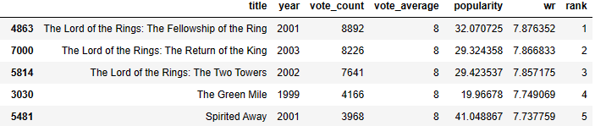


Top 5 Fantasy Movies

Slide 10
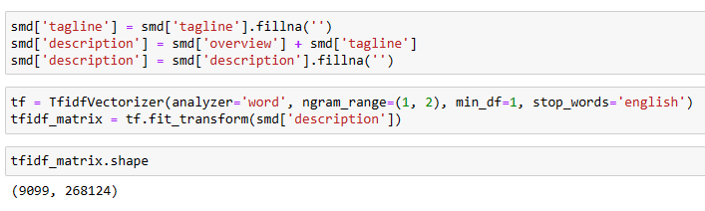
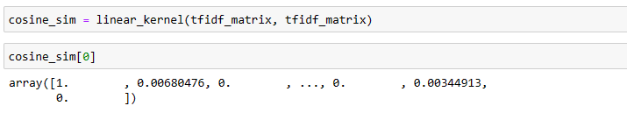
Model 2: Movie Description-Based Recommender
Summary
The Movie Description-Based Recommender offers personalized suggestions grounded in movie descriptions and taglines. Using the TF-IDF Vectorizer, we transformed descriptions into numerical representations and computed Cosine Similarity scores to determine movie similarities. This allowed us to identify the 30 most similar movies for a given title, marking our first step in content-based filtering.
The algorithm involved data preprocessing to handle missing values, combining taglines and overviews to create movie descriptions. Employing the TF-IDF Vectorizer, we converted descriptions into numerical vectors, computed Cosine Similarity scores, and sorted movies based on these scores to provide personalized recommendations.

Slide 11

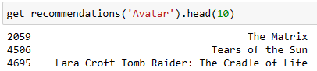
Avatar Movie
Overview:
In the 22nd century, a paraplegic Marine is dispatched to the moon Pandora on a unique mission, but becomes torn between following orders and protecting an alien civilization.
Tagline:
Enter the World of Pandora.

Slide 12
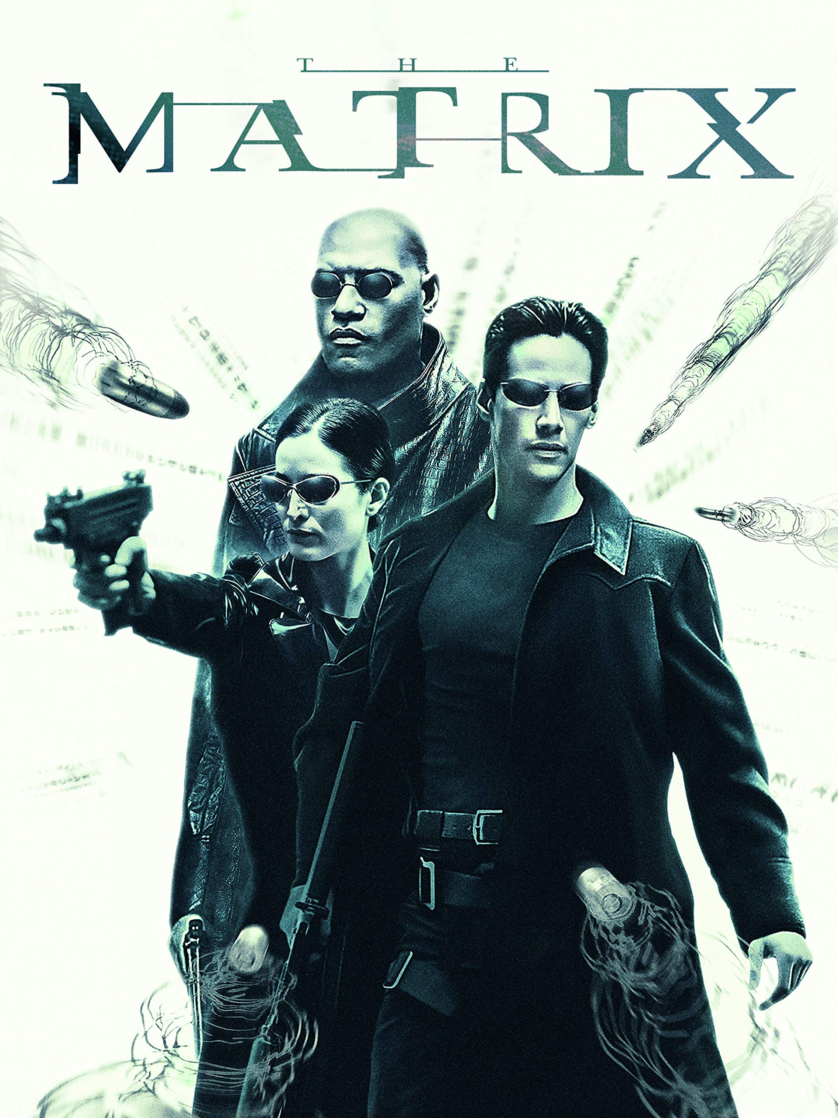
Top 3 Movies Recommended after watching Avatar (Based on Description)
Overview:
Set in the 22nd century, The Matrix tells the story of a computer hacker who joins a group of underground insurgents fighting the vast and powerful computers who now rule the earth.
Tagline:
Welcome to the Real World.

Slide 13

Top 3 Movies Recommended after watching Avatar (Based on Description)
Overview:
Navy SEAL Lieutenant A.K. Waters and his elite squadron of tactical specialists are forced to choose between their duty and their humanity, between following orders by ignoring the conflict that surrounds them, or finding the courage to follow their conscience and protect a group of innocent refugees. When the democratic government of Nigeria collapses and the country is taken over by a ruthless military dictator, Waters, a fiercely loyal and hardened veteran is dispatched on a routine mission to retrieve a Doctors Without Borders physician.
Tagline:
He was trained to follow orders. He became a hero by defying them.

Slide 14
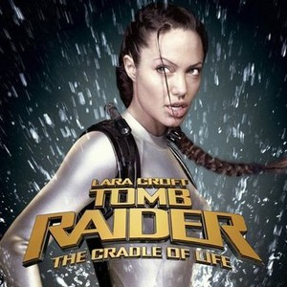
Top 3 Movies Recommended after watching Avatar (Based on Description)
Overview:
Lara Croft ventures to an underwater temple in search of the mythological Pandora's Box but, after securing it, it is promptly stolen by the villainous leader of a Chinese crime syndicate. Lara must recover the box before the syndicate's evil mastermind uses it to construct a weapon of catastrophic capabilities.
Tagline:
Adventuress Lara Croft goes on a quest to save the mythical Pandora's Box.

Slide 15
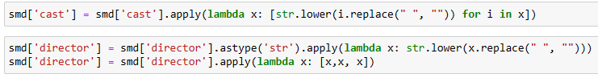
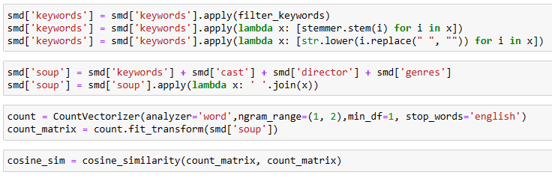
Model 3: Metadata-Based Recommender
Summary The Metadata-Based Recommender personalizes movie recommendations by integrating extensive metadata, including genres, directors, actors, and keywords. Key players like major characters and the director are prioritized, along with important keywords identified through frequency counts. Preprocessed keywords are combined with other features to create a metadata dump, enabling accurate similarity assessments for tailored recommendations.
The Metadata-Based Recommender algorithm involves merging and refining datasets to include essential features like genres, directors, actors, and keywords. Preprocessing steps ensure consistency and relevance, including stripping spaces, converting text to lowercase, and stemming keywords. A metadata dump is created, combining all relevant features for each movie. A Count Vectorizer generates a count matrix to represent word frequencies. Cosine similarity is calculated based on this matrix to identify the most similar movies. Finally, a function retrieves top recommendations using cosine similarity scores and movie indices.

Slide 16

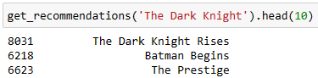
The Dark Knight Movie
Genre: Drama, Action, Crime, Thriller Director: Christopher Nolan Actors: Christian Bale, Heath Ledger, Aaron Eckhart Keywords: dc comics, crime fighter, secret identity, scarecrow, sadism, chaos, gotham city, vigilante, joker, superhero, batman, super powers, super villain, etc.

Slide 17

Top 3 Movies Recommended after watching The Dark Knight (Metadata)
Title: The Dark Knight Rises
Genre: Drama, Action, Crime, Thriller Director: Christopher Nolan Actors: Christian Bale, Tom Hardy, Anne Hathaway Keywords: dc comics, crime fighter, , terrorist, secret identity, burglar, hostage drama, time bomb, gotham city, batman, criminal underworld, etc.

Slide 18

Top 3 Movies Recommended after watching The Dark Knight (Metadata)
Title: Batman Begins
Genre: Drama, Action, Crime Director: Christopher Nolan Actors: Christian Bale, Michael Caine, Ken Watanabe Keywords: himalaya, martial arts, dc comics, crime fighter, secret identity, undercover, superhero, gotham city, vigilante, rivalry, crime, super powers, evil doctor, etc.

Slide 19

Top 3 Movies Recommended after watching The Dark Knight (Metadata)
Title: The Prestige
Genre: Drama, Mystery, Thriller Director: Christopher Nolan Actors: Christian Bale, Hugh Jackman, Scarlett Johansson Keywords: competition, secret, obsession, magic, dying and death, class society, illusion, tricks, hostility, class, rivalry

Slide 20
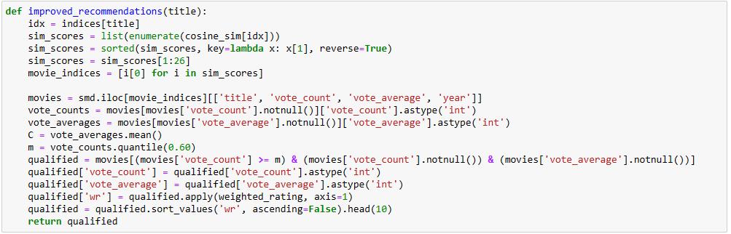
Model 4: Enhanced Recommender Incorporating Popularity and Ratings
Summary
The Enhanced Recommender Incorporating Popularity and Ratings improves the metadata recommendation system by considering both movie ratings and popularity. By excluding poorly rated movies and focusing on popular ones with positive critical responses, this algorithm ensures high-quality recommendations.
The algorithm identifies the top 25 similar movies, calculates a threshold vote count corresponding to the 60th percentile movie ('m'), and computes the weighted rating for each movie using IMDB's formula. It filters out movies that do not meet the minimum vote count threshold and returns the top 10 recommended movies based on their weighted rating and popularity.

Slide 21
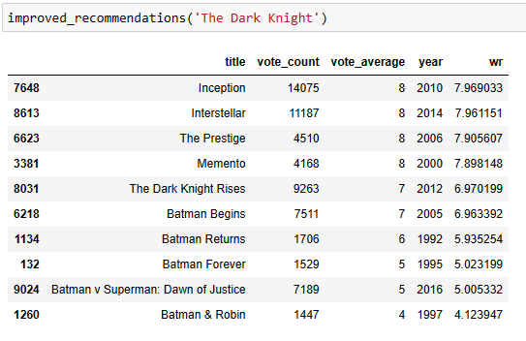
Top 10 Movies Recommended after watching The Dark Knight (Enhanced)

Slide 22
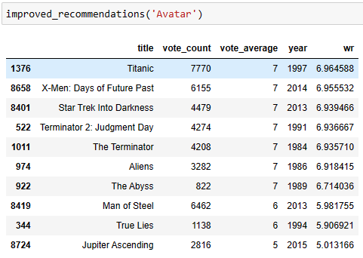
Top 10 Movies Recommended after watching Avatar (Enhanced)

Slide 23

Summary:
We have built 4 different recommendation engines based on various ideas and algorithms. They are as follows:
Simple Recommender: This system utilized overall TMDB Vote Count and Vote Averages to construct Top Movies Charts, both in general and for specific genres. The IMDB Weighted Rating System was employed to calculate ratings, based on which the sorting was ultimately performed.
Movie Description-Based Recommender: This recommender leveraged movie descriptions and taglines to identify similarities between movies. Using TF-IDF Vectorizer and Cosine Similarity, it recommended movies that were most similar to a particular movie based on its textual content.
Metadata-Based Recommender: This system incorporated a more comprehensive set of metadata including genres, directors, main actors, and keywords. By utilizing a Count Vectorizer to create a count matrix, it identified similarities between movies based on this metadata and recommended similar movies.
Enhanced Recommender Incorporating Popularity and Ratings: This recommender further enhanced the metadata-based approach by considering the popularity and ratings of movies. It excluded poorly rated movies and focused on popular ones with positive critical responses. Using IMDB's formula, it calculated weighted ratings for each movie to provide more refined recommendations.

Slide 24

Relevance of Study to AI and Business
Personalization and User Experience: AI recommendation systems enhance user experience by providing personalized content, products, or services tailored to individual preferences, leading to increased user engagement, satisfaction, and retention.
Efficiency and Effectiveness: These systems optimize decision-making processes by automatically filtering and presenting relevant information, reducing information overload and enabling users to make more informed choices in less time.
Business Growth and Revenue: AI recommendations drive sales and revenue growth by promoting relevant products or services to users, increasing conversion rates, and fostering customer loyalty and repeat purchases.
Content Discovery and Exploration: AI recommendation systems facilitate content discovery and exploration by introducing users to new and diverse content aligned with their interests, expanding their knowledge and entertainment options.
Data-driven Insights and Decision Making: These systems generate valuable insights from user behavior and preferences, enabling organizations to make data-driven decisions, improve product offerings, and optimize marketing strategies.

Slide 25

Recommendations:
Enhanced Personalization: Implement advanced techniques, such as collaborative filtering, to tailor recommendations to individual user interests.
Diversity of Recommendations: Ensure a broader range of content is recommended to users to avoid repetition.
Real-Time Updates: Incorporate mechanisms for real-time updates of the recommendation model based on user interactions.
Contextual Understanding: Improve the system's ability to understand contextual factors for more relevant recommendations.
Ethical Considerations: Integrate ethical considerations to ensure fairness, diversity, and privacy protection in recommendations.

Slide 26
Suggestions for System Enhancement
1. Consider implementing a two-tower model that combines an embedding system with collaborative filtering and content-based approaches. This model leverages the strengths of both collaborative filtering, which recommends items based on user similarities, and content-based filtering, which recommends items based on their attributes. By utilizing embeddings, this approach can effectively capture complex relationships between users and items, leading to more accurate and personalized recommendations.
2. Explore the possibility of adopting a knowledge graph-based solution. Knowledge graphs organize information in a structured format, representing entities and their relationships. By constructing a knowledge graph of movies, users, genres, actors, directors, and other relevant entities, you can capture rich semantic information and infer meaningful connections between them. This approach enables sophisticated recommendation strategies, such as graph-based traversal algorithms, to uncover hidden relationships and provide context-aware recommendations that better reflect users' preferences and interests.

Slide 27

Up Next: The King's Indian Featuring: Denver Magtibay Director: Tae Hwan Kim Producer: Rachit Garg

